Slide 1
DAP (DATA ANALYSIS AND PLANNING) TEAMS
THE POWER OF TEACHERS’ COLLECTIVE EXPERTISE

Slide 2
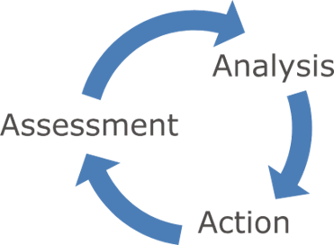
Data Driven Instruction
Data Driven Instruction (DDI) is a precise and systematic approach to improving student learning throughout the year. The cycle of data-driven instruction includes assessment, analysis, and action and is a key framework for school-wide/District wide support of all student success.

Slide 3
Belief About Adult Learners
Adult learners are self-directed.
Adult learners seek out collaboration.
Adults bring a variety of experiences that should be utilized in their learning.
Adult learners are intrinsically motivated and work best when learning has clear, relevant goals.
Glickman, C., Gordon, S., and Ross-Gordon, J. (2007). Supervision and instructional leadership: A development approach. New York: Pearson.

Slide 4
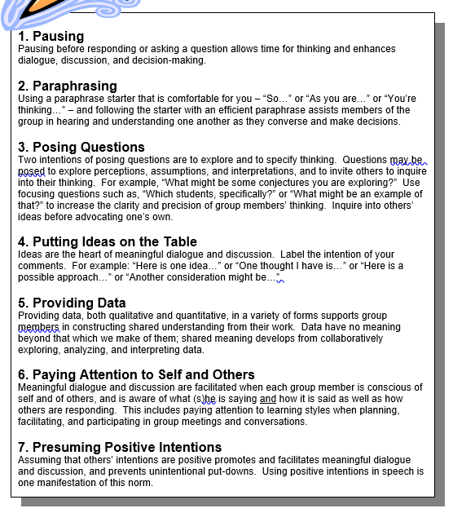
Norms of Collaboration
DAP meetings follow the Seven Norms of Collaboration from the Center of Adaptive Schools

Slide 5
Inclusion Activity
The purpose of the Inclusion Activity is to build a culture of collaboration
Activities should allow participants to either practice one or more of the Norms of Collaboration or for particpants to get acquainted with one another

Slide 6
Process | Tools/Resources
Step 1: Organize Standard Level Data
Review State Test District Wide Data A. Look for standards where students exceeded the norm B. Look for standards where students had largest gaps from the norm C. Cross Reference deficit standards with trend data for highly tested standards D. Focus on 2-3 standards for intentional teaching. | Level 1 Benchmark Analysis Data/ Gap Analysis data State Test Trend Map report
Step 2: Item Level Analysis
A. Determine what the questions are asking students to do: * What skills/concepts do they need to know to answer the question correctly? B. Look at the answer choices: *What are the distractors * Make predictions as to misconceptions or confusion as to why students may have chosen a common wrong answer | Item analysis by District report Grade level Standards Analysis Plan
Step 3: Brainstorm Strategies to Address Needs
A. Based upon Focus Standards and identified misconceptions/deficits, create lessons and activities (DINS) to strengthen student proficiencies in these areas. | Group Battle Plan Short Cycle Action Plan
DAP Process​

Slide 7
Step 1: Standards Analysis
State Test Data Analysis
(Gap and Comparison Reports)
Trend Map Data Analysis
Standards Level Analysis
​

Slide 8
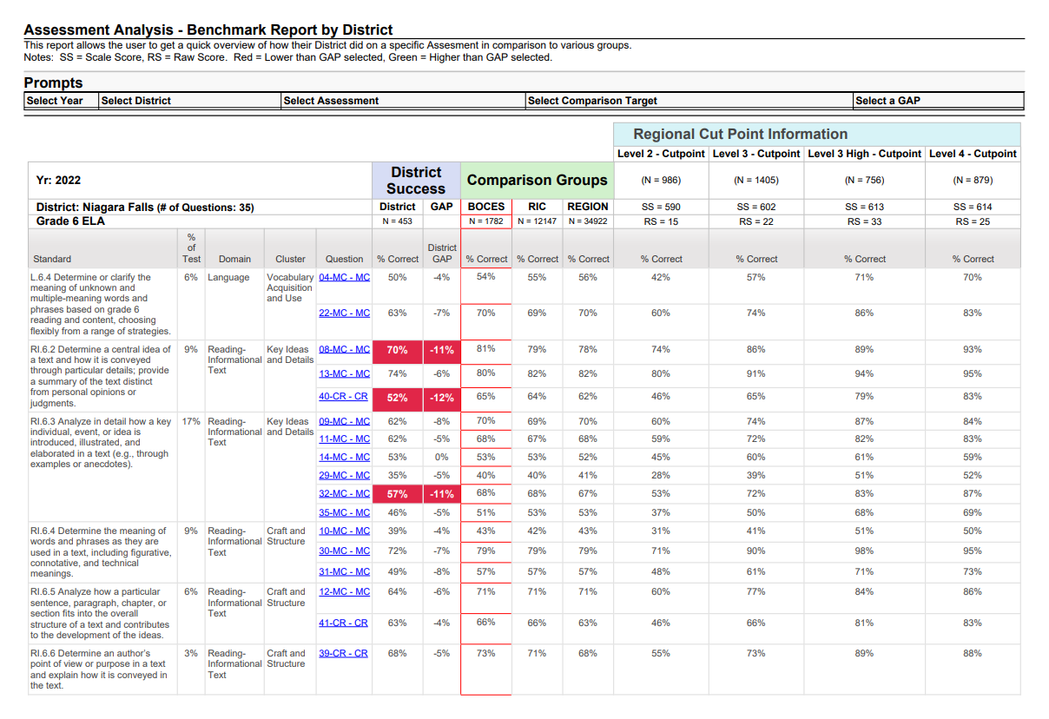

Slide 9
Standard Level Analysis By Grade Level
Grade Level: |  | Subject: | Assessment: | Test Date:
Grade Level Team Performance | How did students perform across the Grade Level Team? What trends do you notice?
Standard | 54% or above | 53% or below

Slide 10
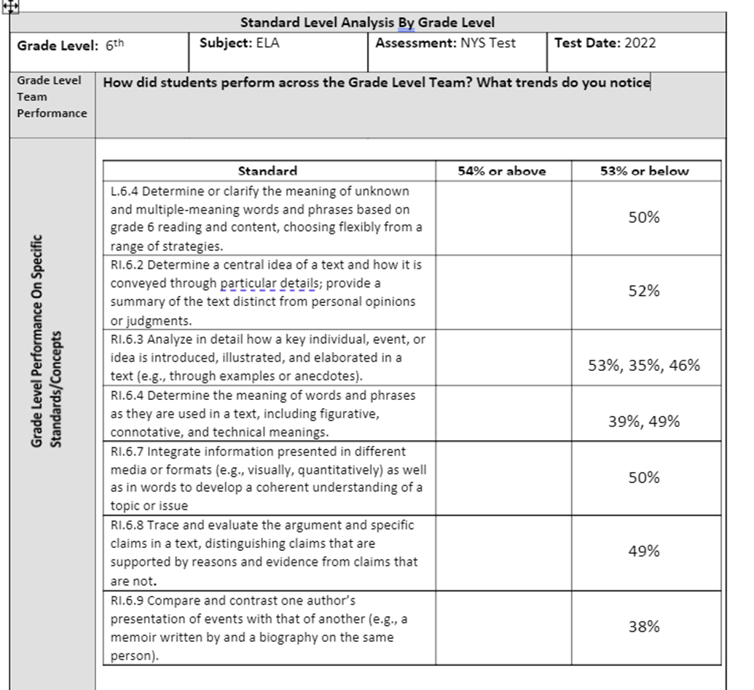

Slide 11
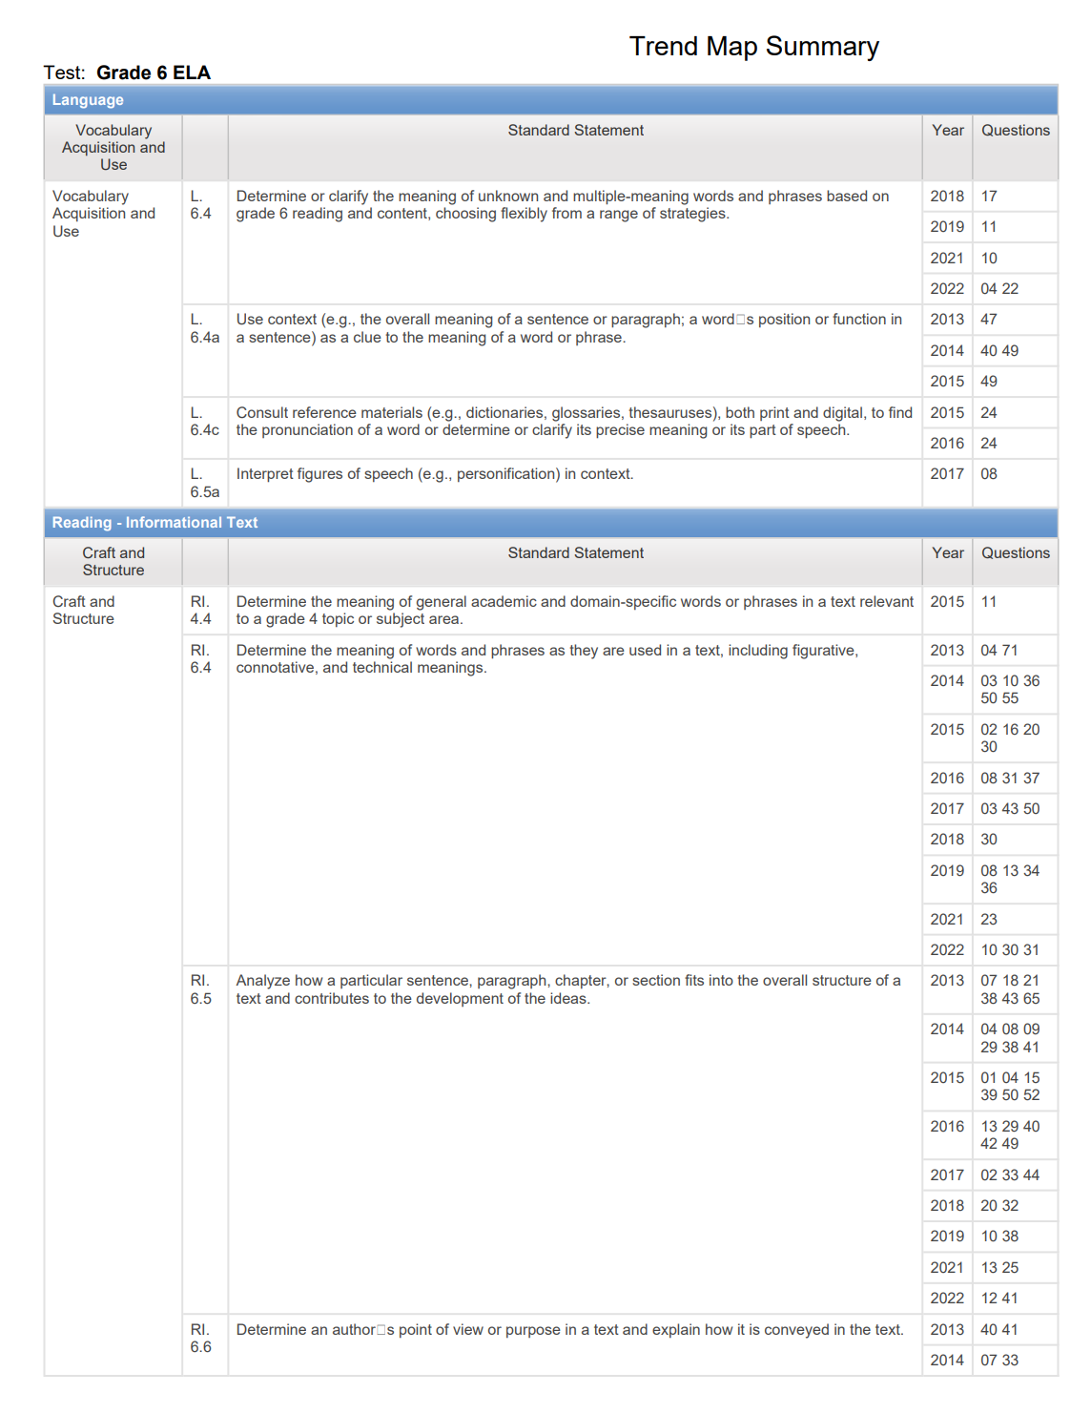
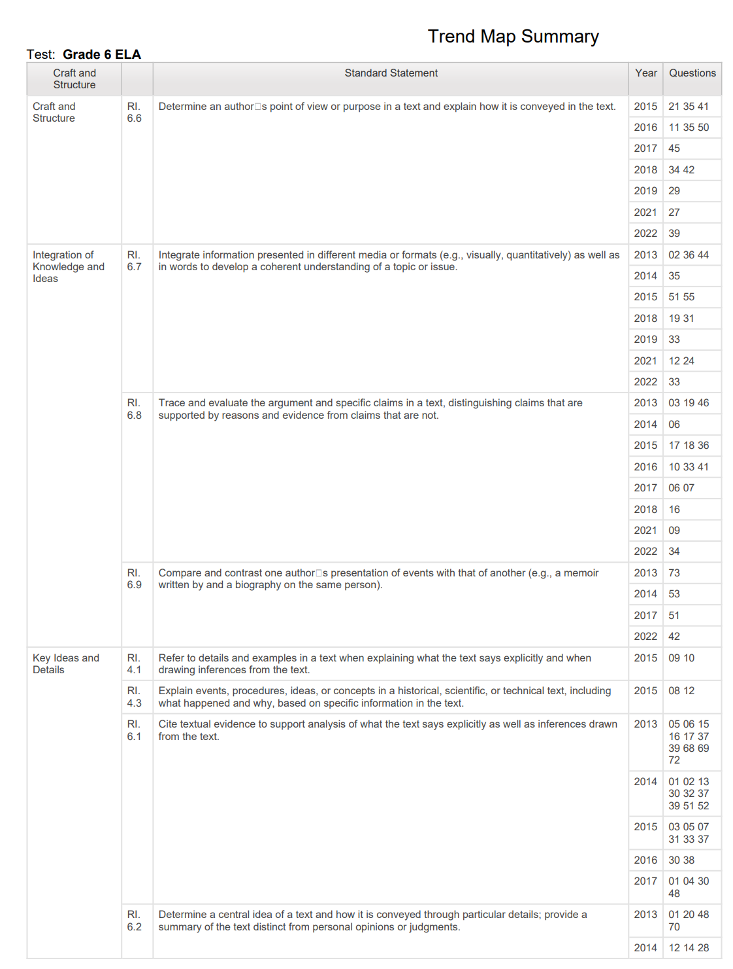

Slide 12
Step 2: Item Analysis
State Test Data Item Analysis
Group Battle Plan

Slide 13
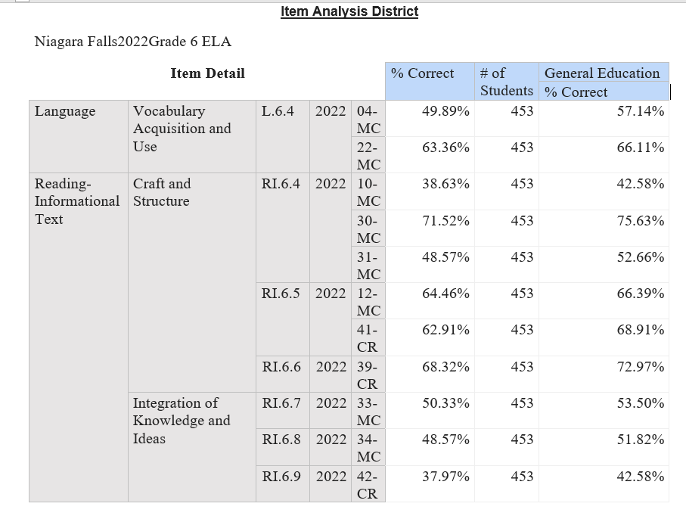
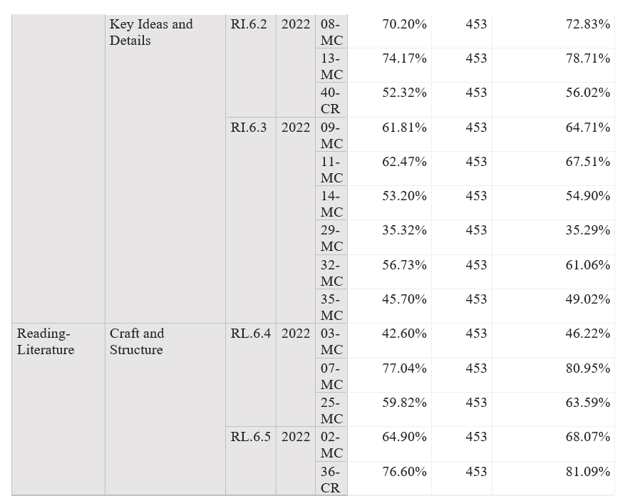
District Item Analysis Report

Slide 14
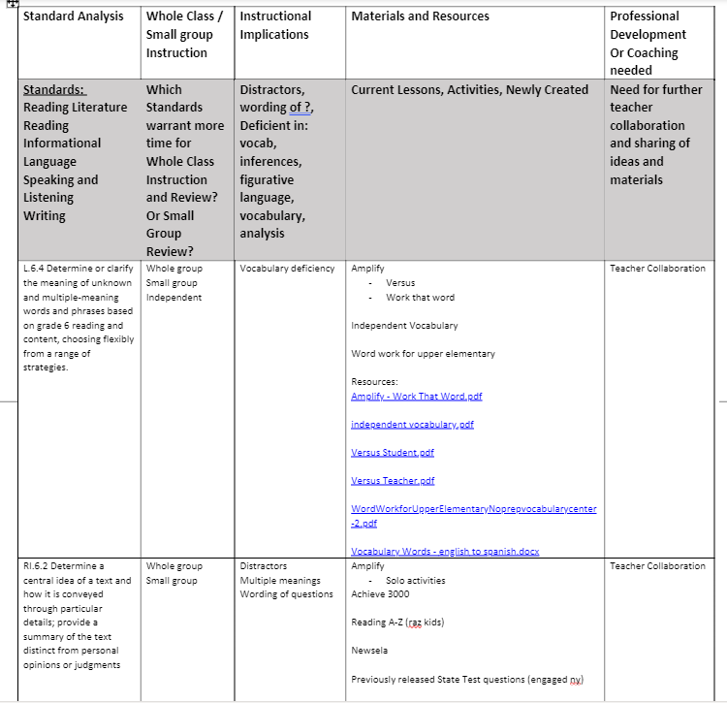
Group Battle Plan

Slide 15
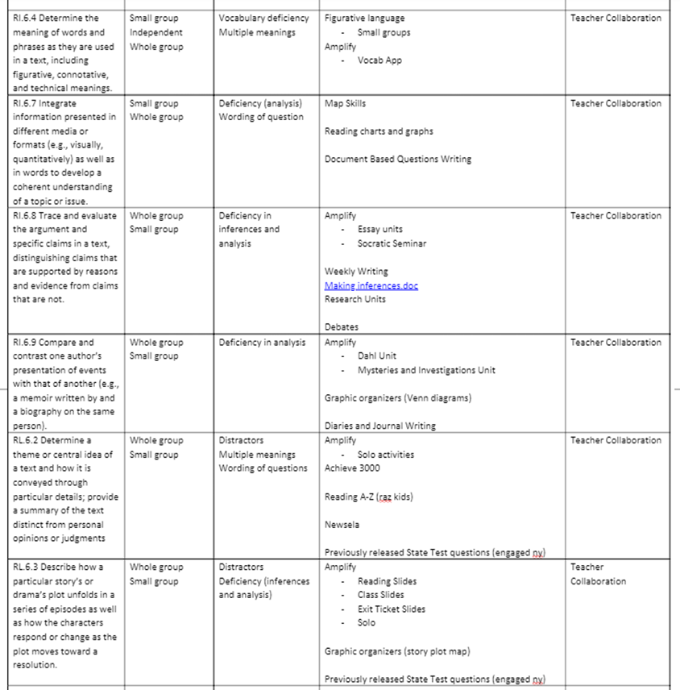

Slide 16
DIN/Battle Plan Activities Examples
Amplify Reveal Words/Vocabulary List To attack vocabulary within the Amplify Curriculum: “Work that Word” activities (in each Amplify in course materials) Students review their revealed words… the eReader keeps track of which words students have “revealed,” and they can easily access their specific list of words in a personal glossary within the Amplify Library. QUIZIZZ Boy: Tales of Childhood
Impression: lasting effect Lapse: period of time Seared: burned Consciousness: level of awareness Vividly: clearly Drawback: problem Hag: ugly old woman Loathsome: hated Precious: very Tramp: beggar Sullen: gloomy | Foul: dirty Prised: pulled Conkers: chestnuts Hoard: stored treasure Strive: try Modesty: not wanting to show off Sheer: complete Desperados: criminals Strutting: walking proudly Victors: winners

Slide 17
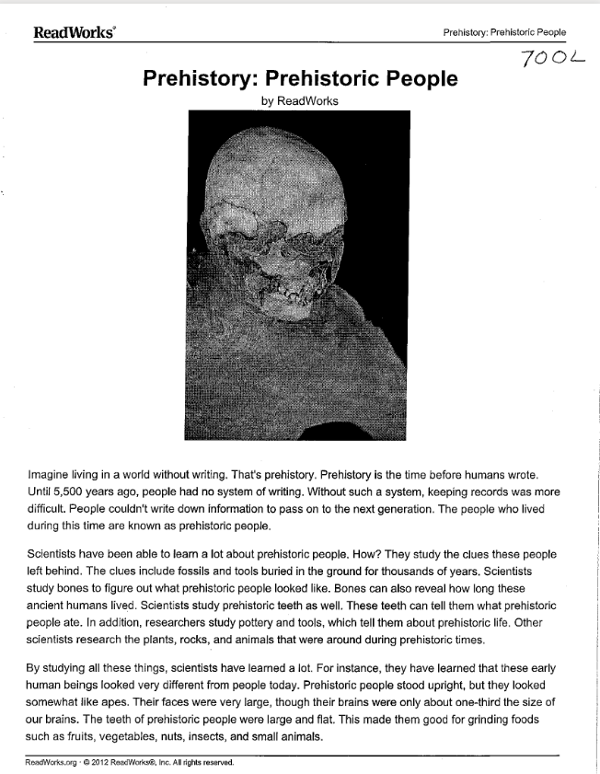
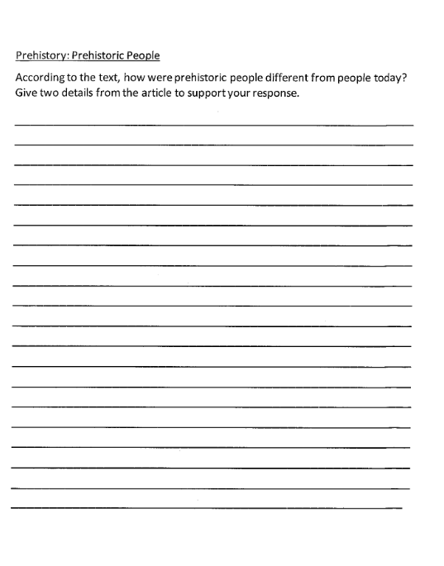

Slide 18
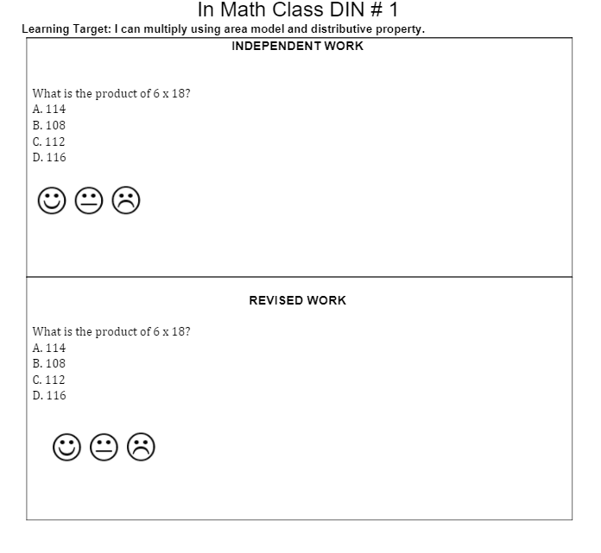
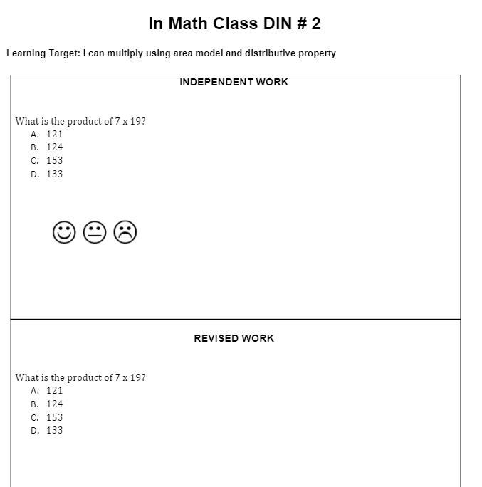

Slide 19
SMART Student-Learning Goal: To increase the average points of 2-points responses from .71 to 1 by the date of the next Interim: Week of January 3-9, 2023.
Instructional or Re-teaching Strategy We Agree On:
Continue to roll our RACE strategy Implement Task Deconstruction with students (Self-assessment) Lesson 1: Introduce the form Lesson 2: Anthology- what is it and what is the purpose? Lesson 3: Model Anthology: Compile student work samples (5) of varying scores Begin to implement My Write Smart and continue to use throughout the year Each Day 4 and Day 5, 30 minutes will be devoted to direct instruction in CR
Short Cycle Action Plan

Slide 20
Process | Tools/Resources
STEP 4: Classroom Level Analysis
Use State and Local Test Data to: A. Analyze for whole class; small group areas of major concern B. Identify Possible Student Contributing Factors C. Identify Possible Teacher Contributing Factors D. Brainstorm Re-teaching Activities | Standard Level Analysis By Teacher Item Level Analysis By Teacher Student class list Additional local Interim assessment data
School Level DAP

Slide 21
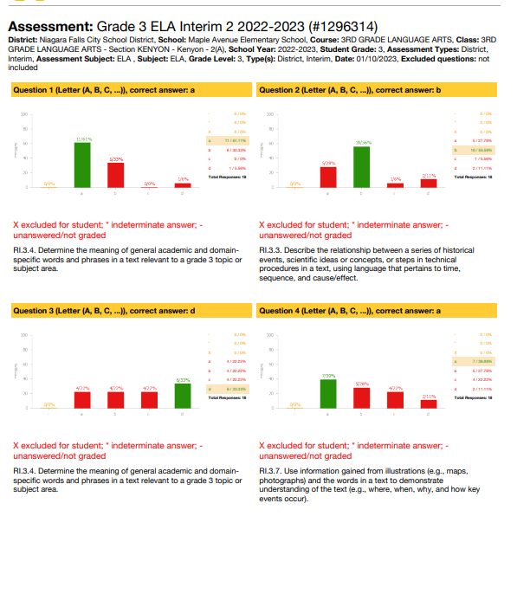
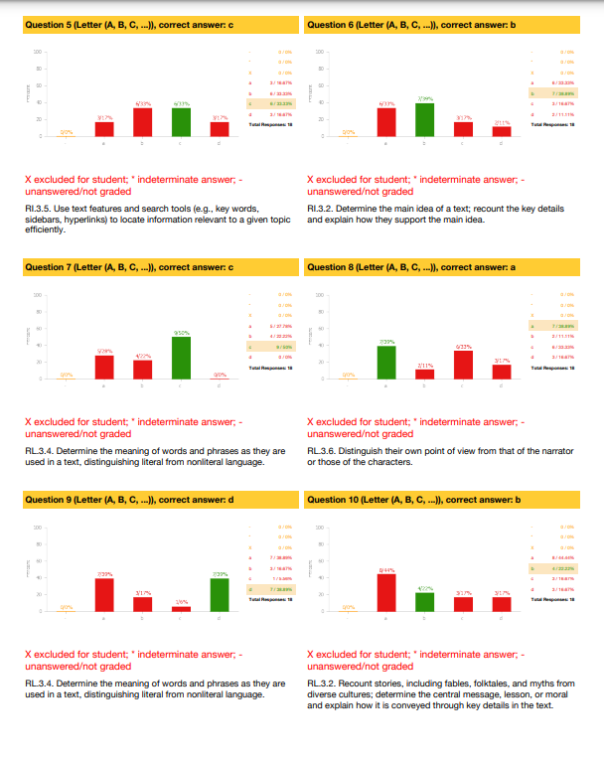

Slide 22
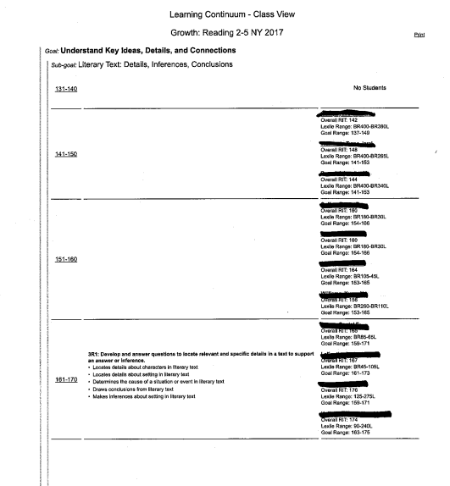
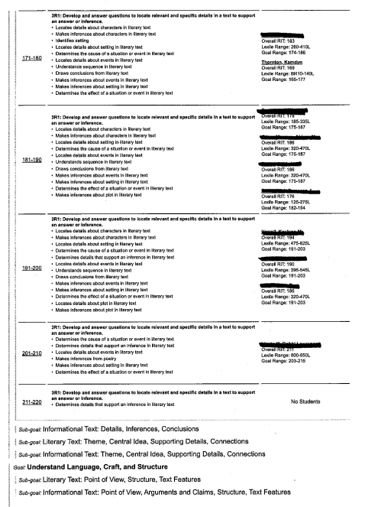

Slide 23
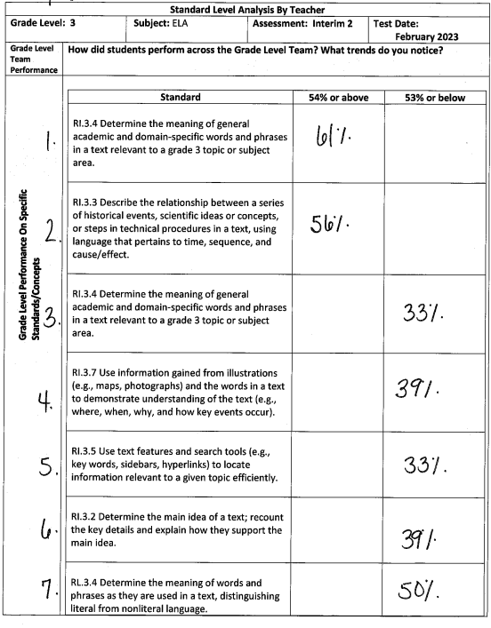
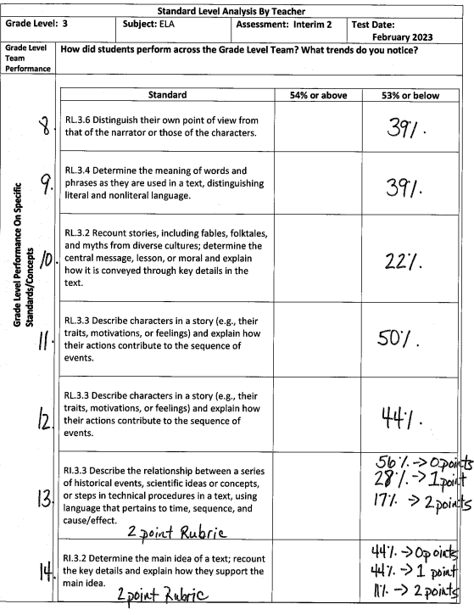

Slide 24
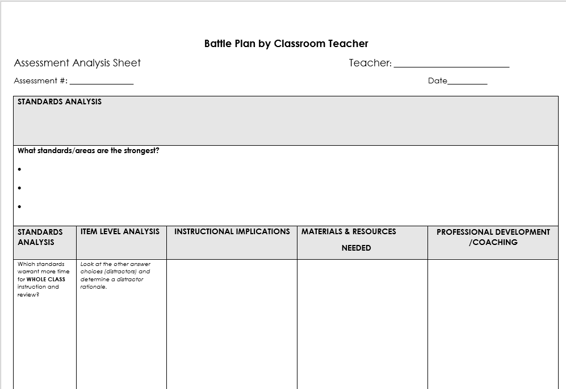

Slide 25
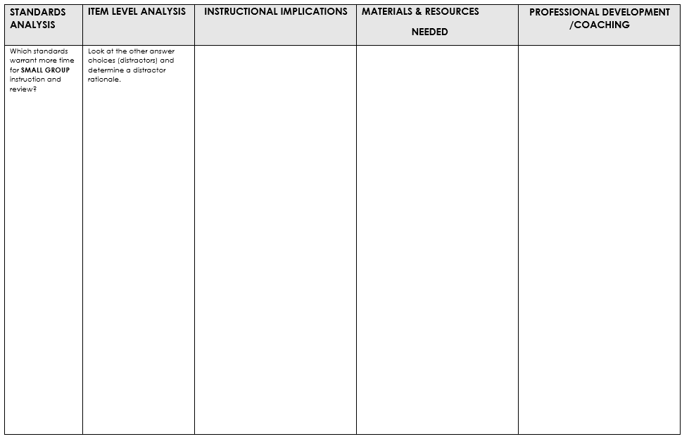

Slide 26
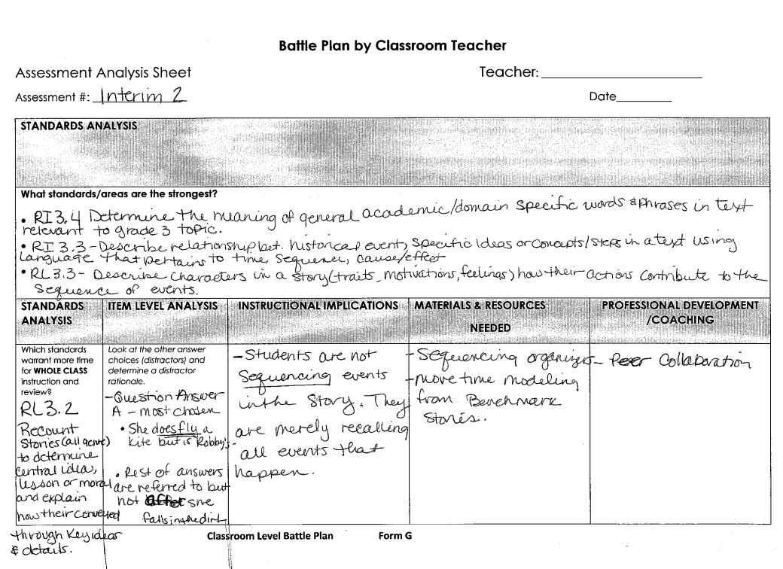

Slide 27
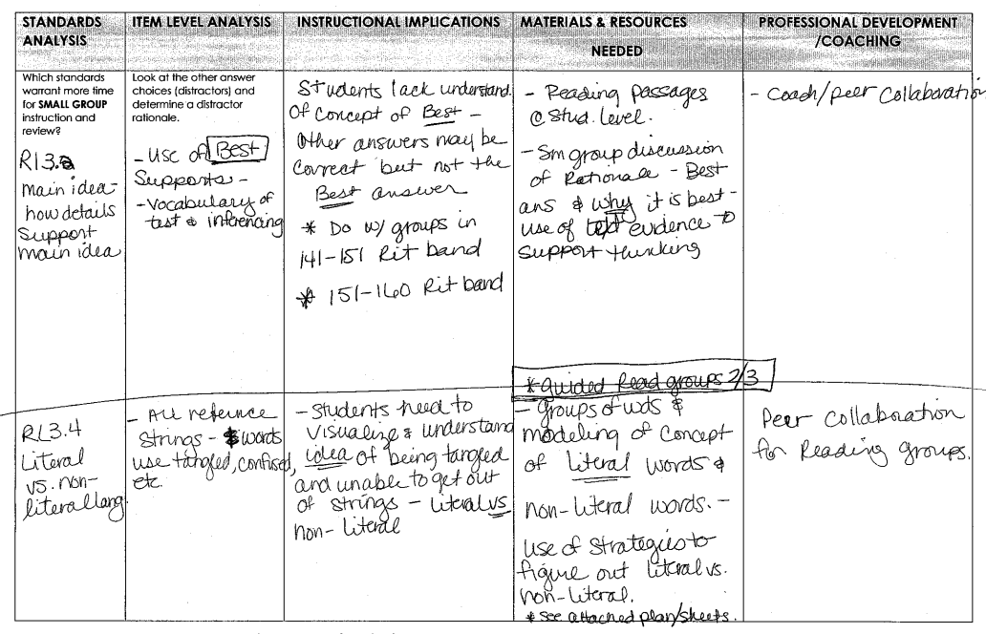

Slide 28
PLUSES
&
WISHES

Slide 29
5th Grade Math DAP
Pluses and Wishes
Pluses
Great group collaboration
Productive session
Collaboration time with other 5th grade teachers
Tech ideas that will work with remote class
Having time to create resources that we can use that are applicable for all involved
Teacher collaboration super helpful with planning
Nice to see that others are struggling with same things
Walk away with great resources to use immediately
Very helpful to have 24 one- problem activities to use daily with students
Wishes
Have more time to plan and collaborate at grade level.
More time to collaborate with remote teachers.
Additional PD on remote learning math resources.
PLC plan more often on Wednesday planning time.
To have all hybrid students back in the classroom 4 days a week.
Get rid of Investigations.

Slide 30
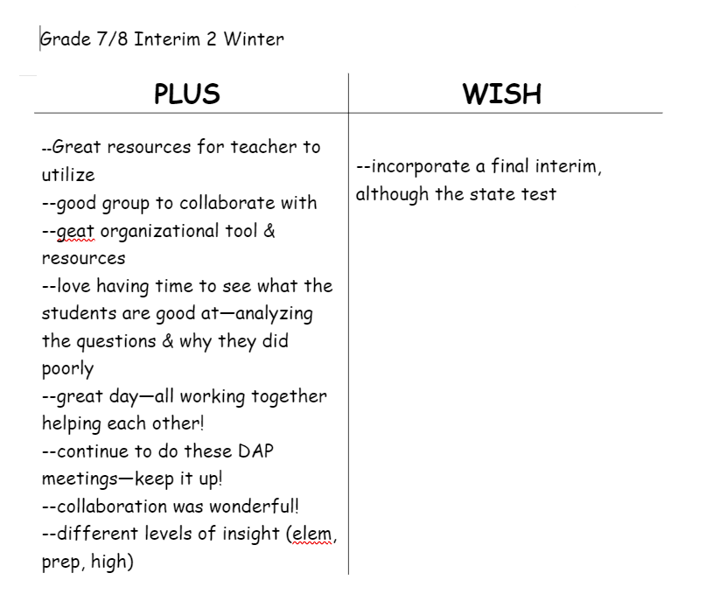

Slide 31
Final DAP Minutes
3/19/2022
Plusses (+) Collaboration Walk away with useful resources Resources to guide small group instruction | Minuses (-) Time constraints to complete the created materials No vertical alignment
Wishes for next Time:
DAP share out for each grade level district wide through department meetings/ PD days, etc. (R)
More participation from new teachers
More support in data analysis for new teachers
Vertical alignment chart for skills through grade 8
After school DAP to share resources
Lead teacher to facilitate
DAP should be a continuous process
Sister Schools - Communicate with 2nd grade to prepare
Prepare schedule for next year DAP ahead of time
Use what we did this year to begin next year
Celebrate the movement
Look at the State Test data over the summer to see if our DAP resources worked
Math took a bigger dip in learning then ELA
Students are not able to “show” their thinking on the computers
Special Ed students may need to do paper pencil test
Bridges or Ramp up for students going into the next grade level are really needed
Need to have summer work to refocus the testing and then provide resources to support the mastery of the standards.

